Slide 1
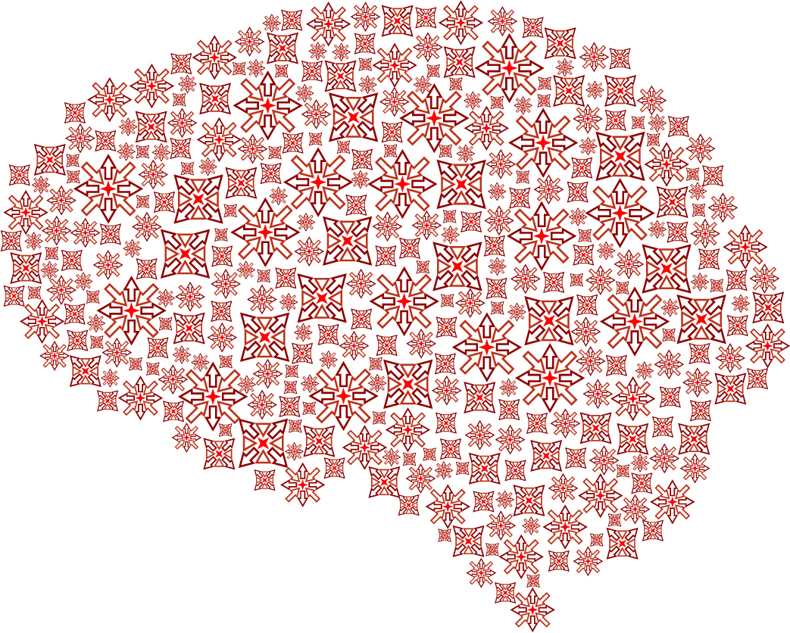

Spatial Patterns for Discriminative Estimation (SPADE)
Alberto Llera
Statistics in Neuroimage
Donders Centre for Cognitive Neuroimaging
Radboud University Nijmegen
a.llera@donders.ru.nl

Slide 2
SPADE ♤
Assume a time-series two class classification problem.
EEG data from right vs left hand movement
rfMRI from two different cohorts (ASD vs Controls)
The idea of SPADE is to project the data in a space in which the difference between the variance of the two classes is maximal.
SPADE is based in the simultaneous diagonalization of two
symmetric matrices, originally described by K. Fukunaga in
”Introduction to statistical pattern recognition”
A simple variation of SPADE is commonly used for Brain computer interfaces (BCI) feature extraction

Slide 3
SPADE ♤
Technically, SPADE performs a simultaneous supervised generalized eigenvalue decomposition of the groups covariance matrices.
This gives as a new basis for the time-series data.
The representation of the data with respect to this new basis
provides discriminative dimensions in terms of variance.
Usually, high discrimination can be achieved at low dimensionality
The dimensions (generalized eigen-vectors) that are discriminative can be mapped back to the the spatial domain (brain).

Slide 4
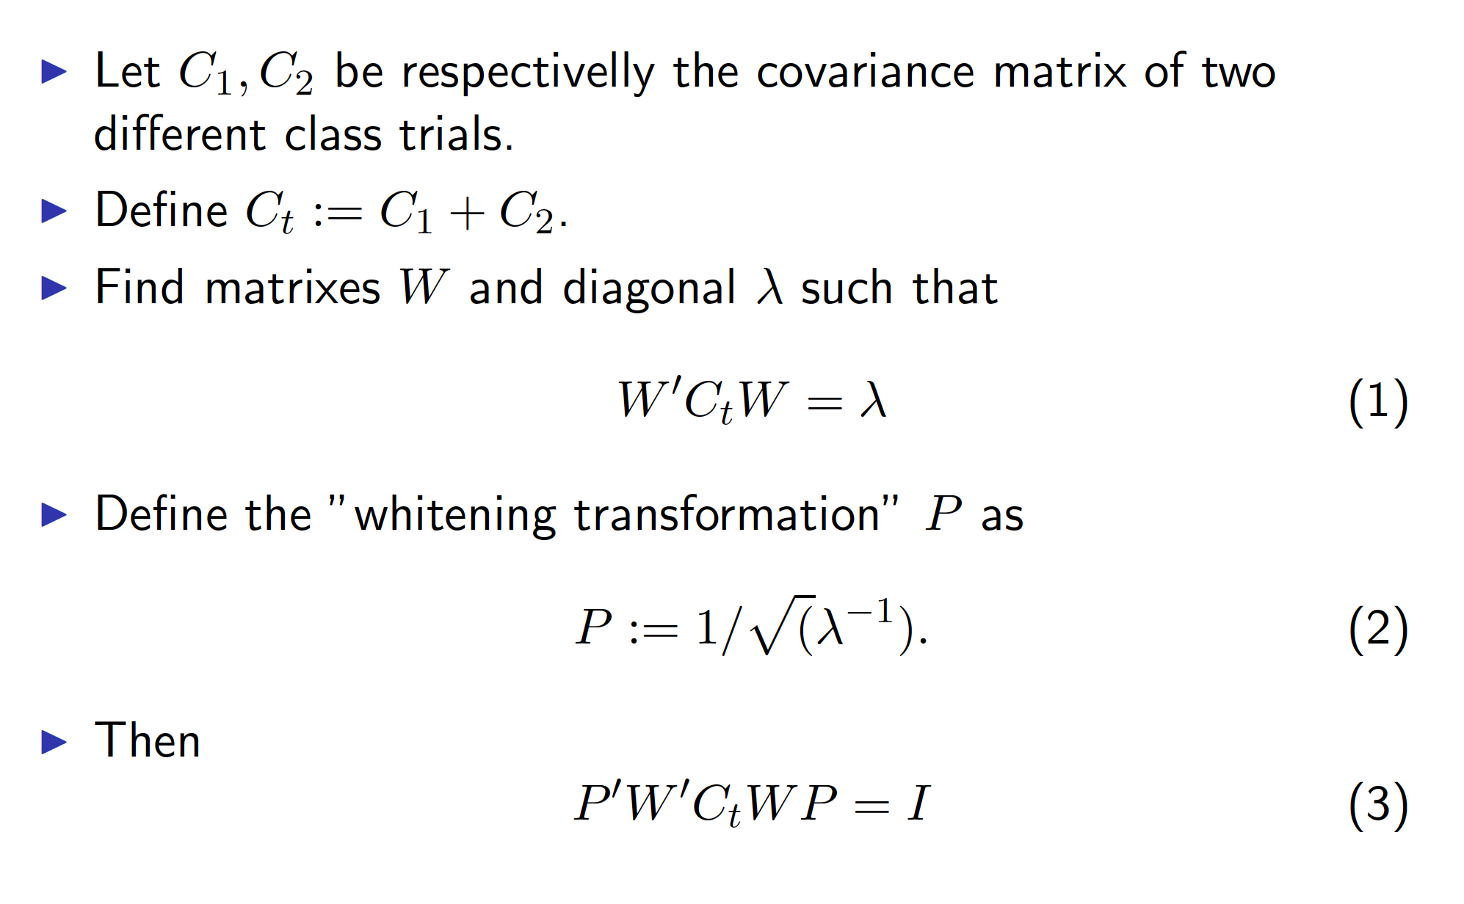
SPADE ♤ Derivations

Slide 5
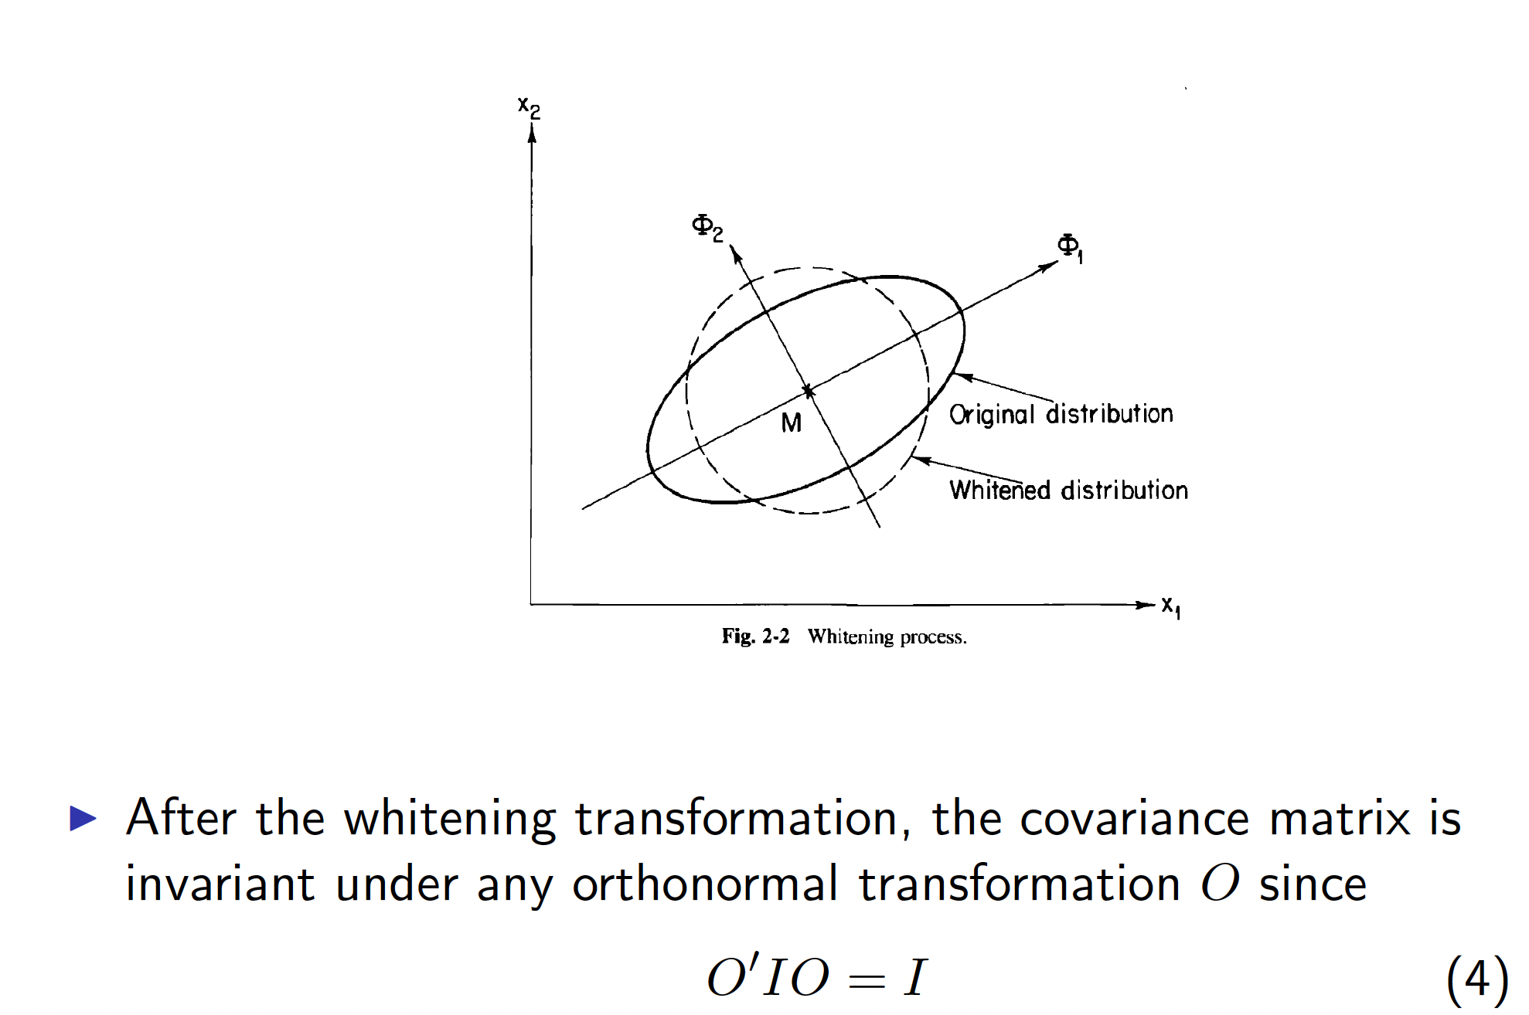
SPADE ♤ Derivations

Slide 6
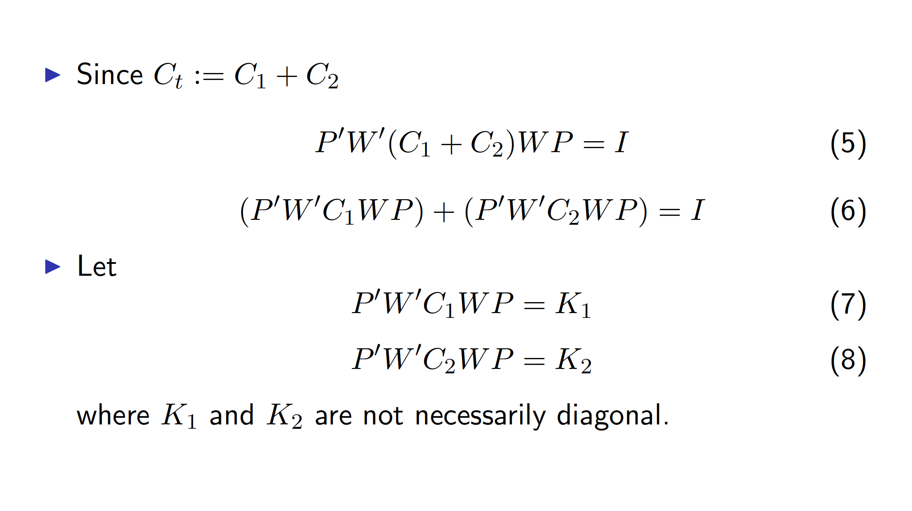
SPADE ♤ Derivations

Slide 7
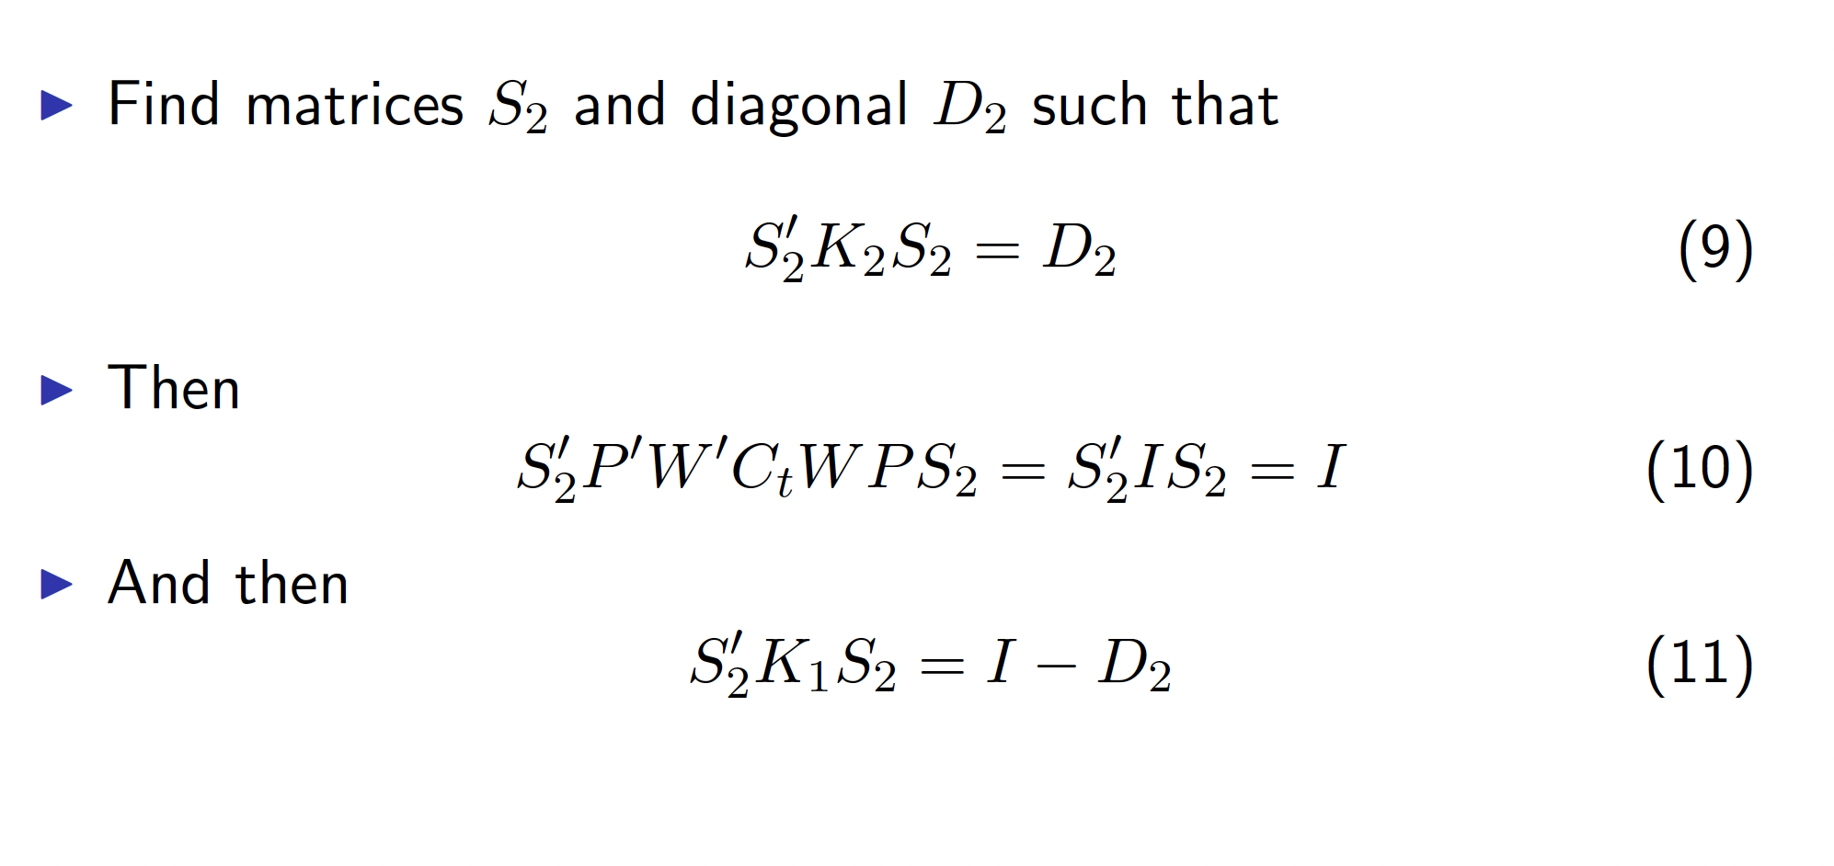
SPADE ♤ Derivations

Slide 8
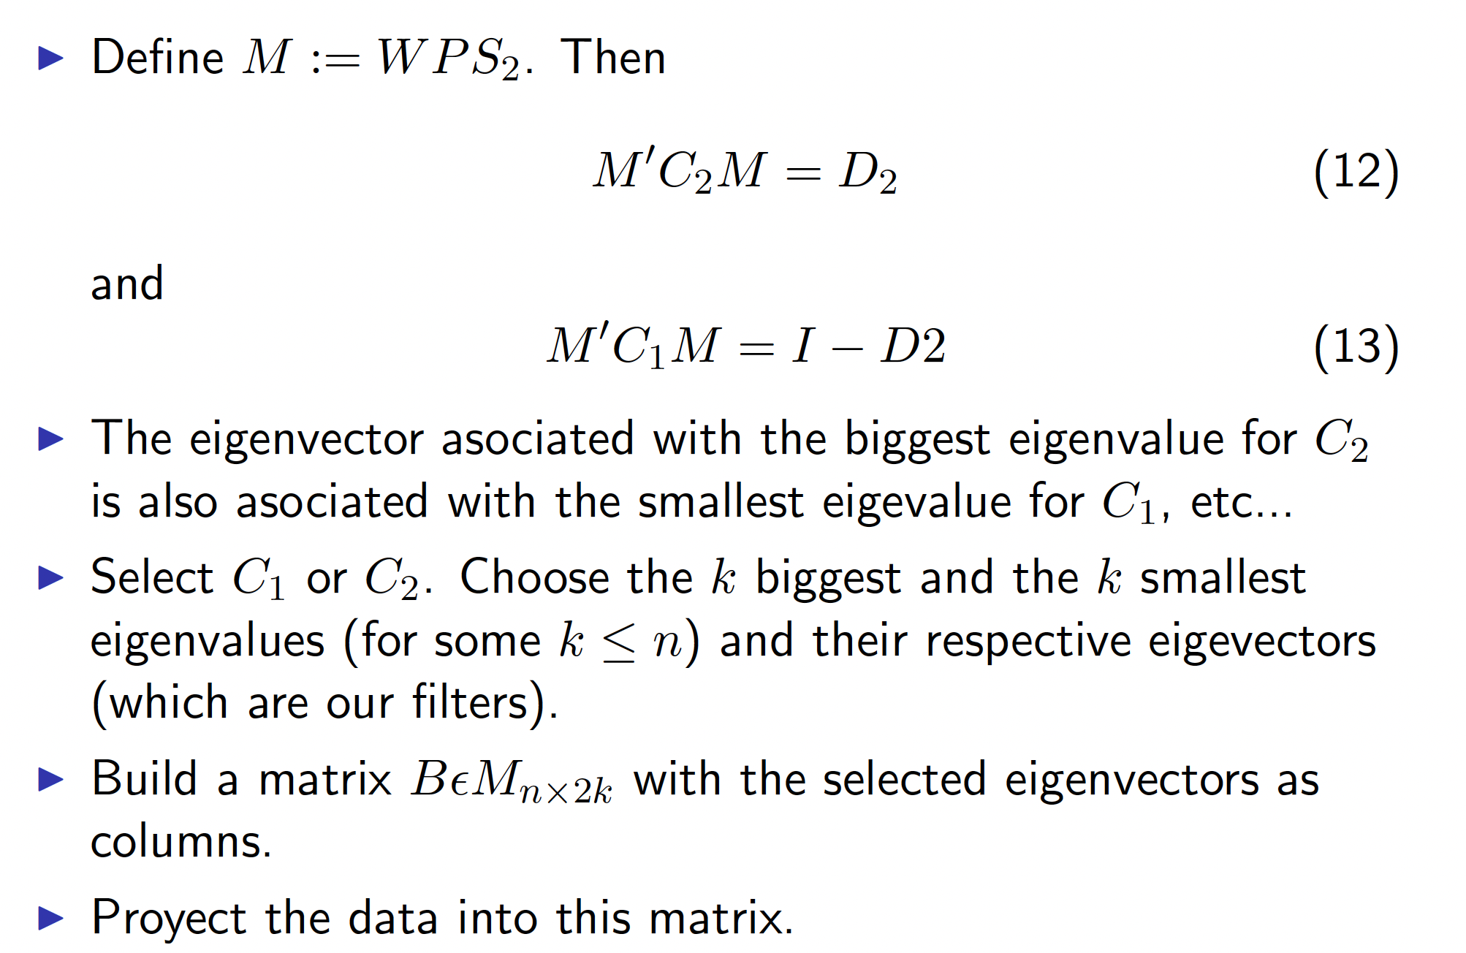
SPADE ♤ Derivations

Slide 9
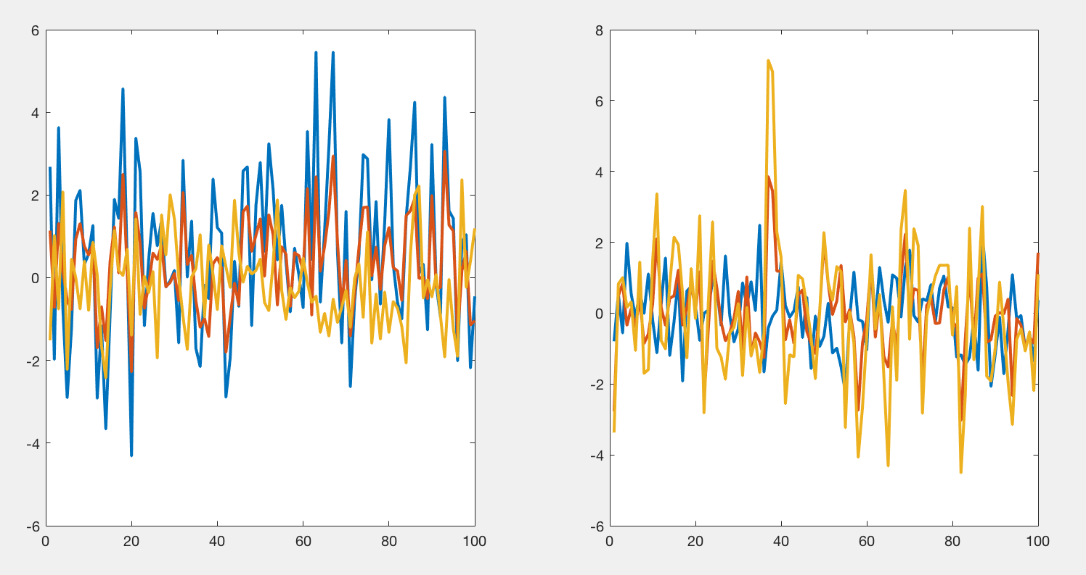
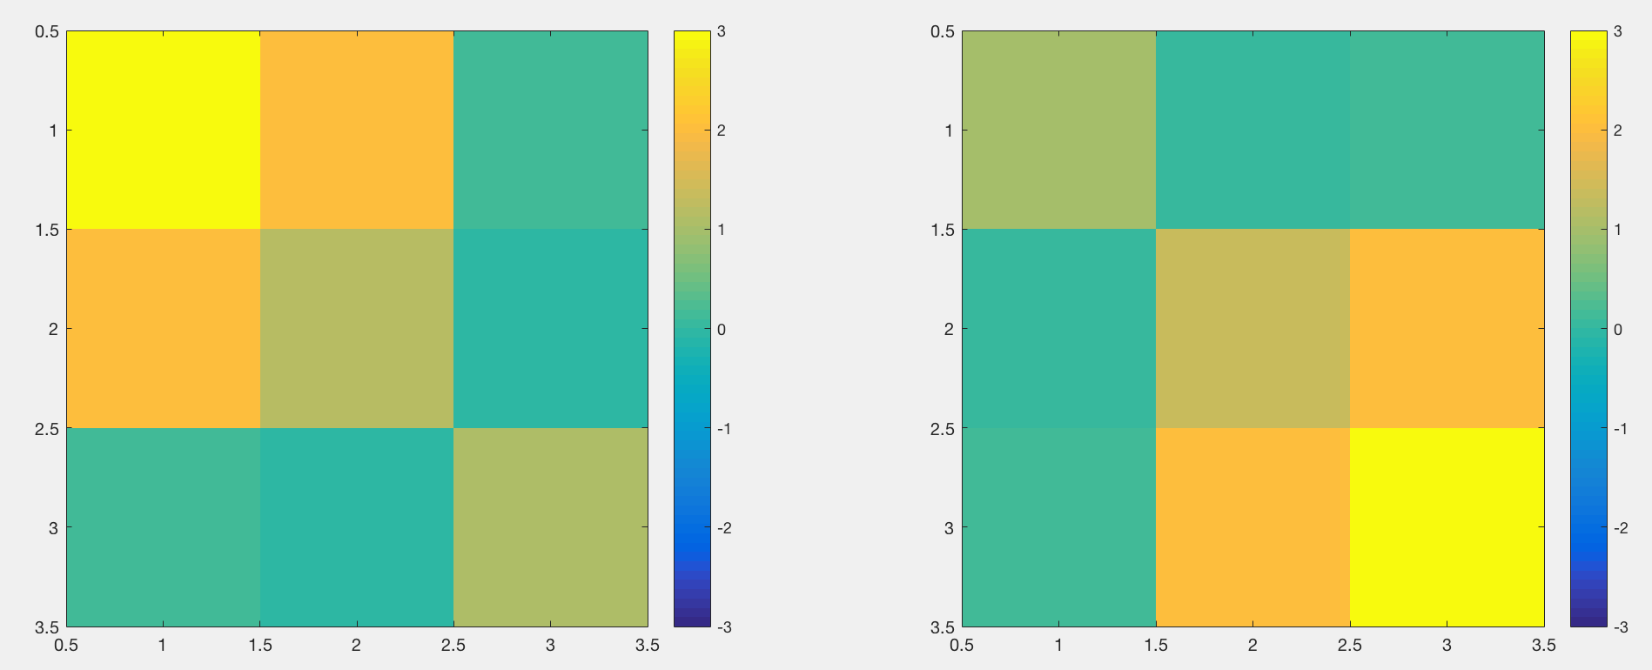
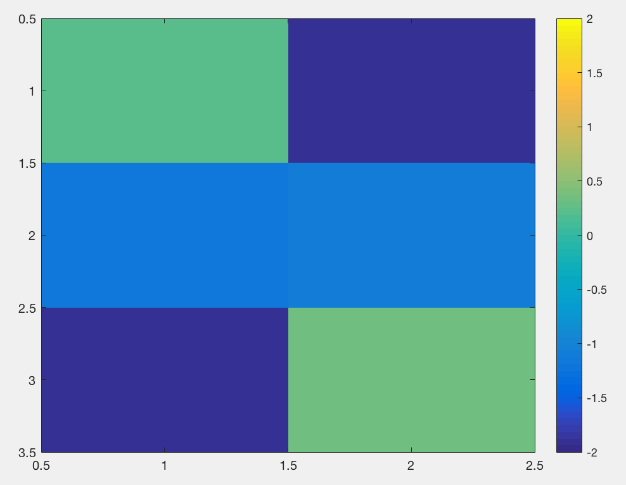
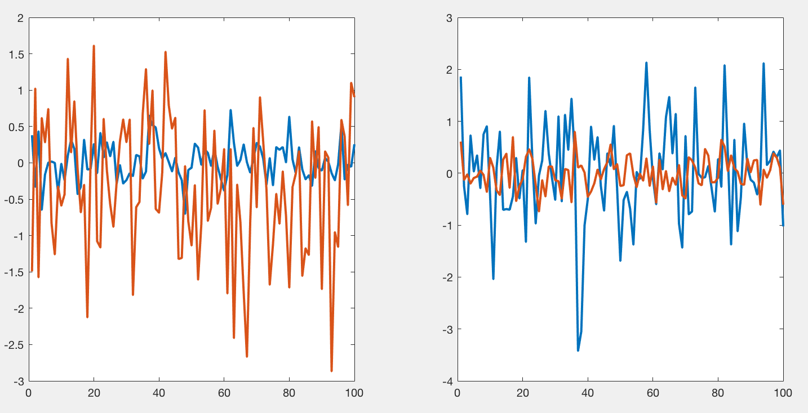
SPADE ♤ Simulated data
Example: 3 temporal series (voxels), 2 conditions.
Two strongest SPADE ‘filters’
Data representation with respect to two strongest SPADE dimensions

Slide 10
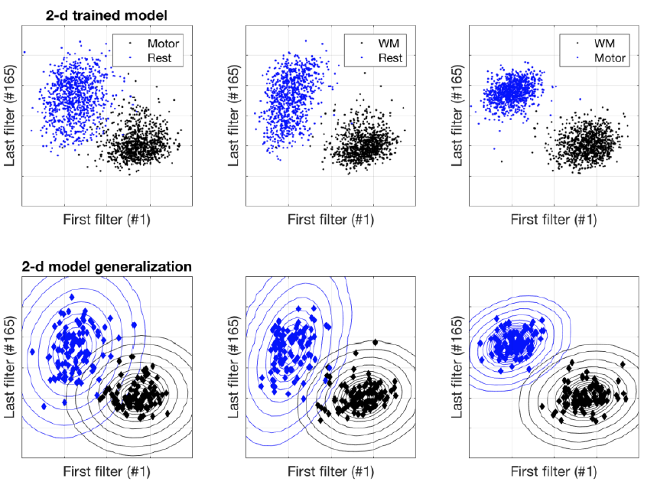
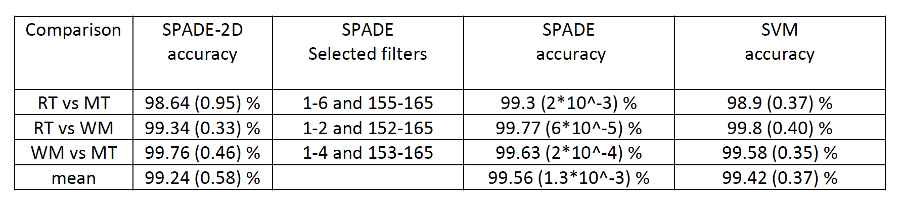
SPADE ♤
Example: fMRI HCP data

Slide 11
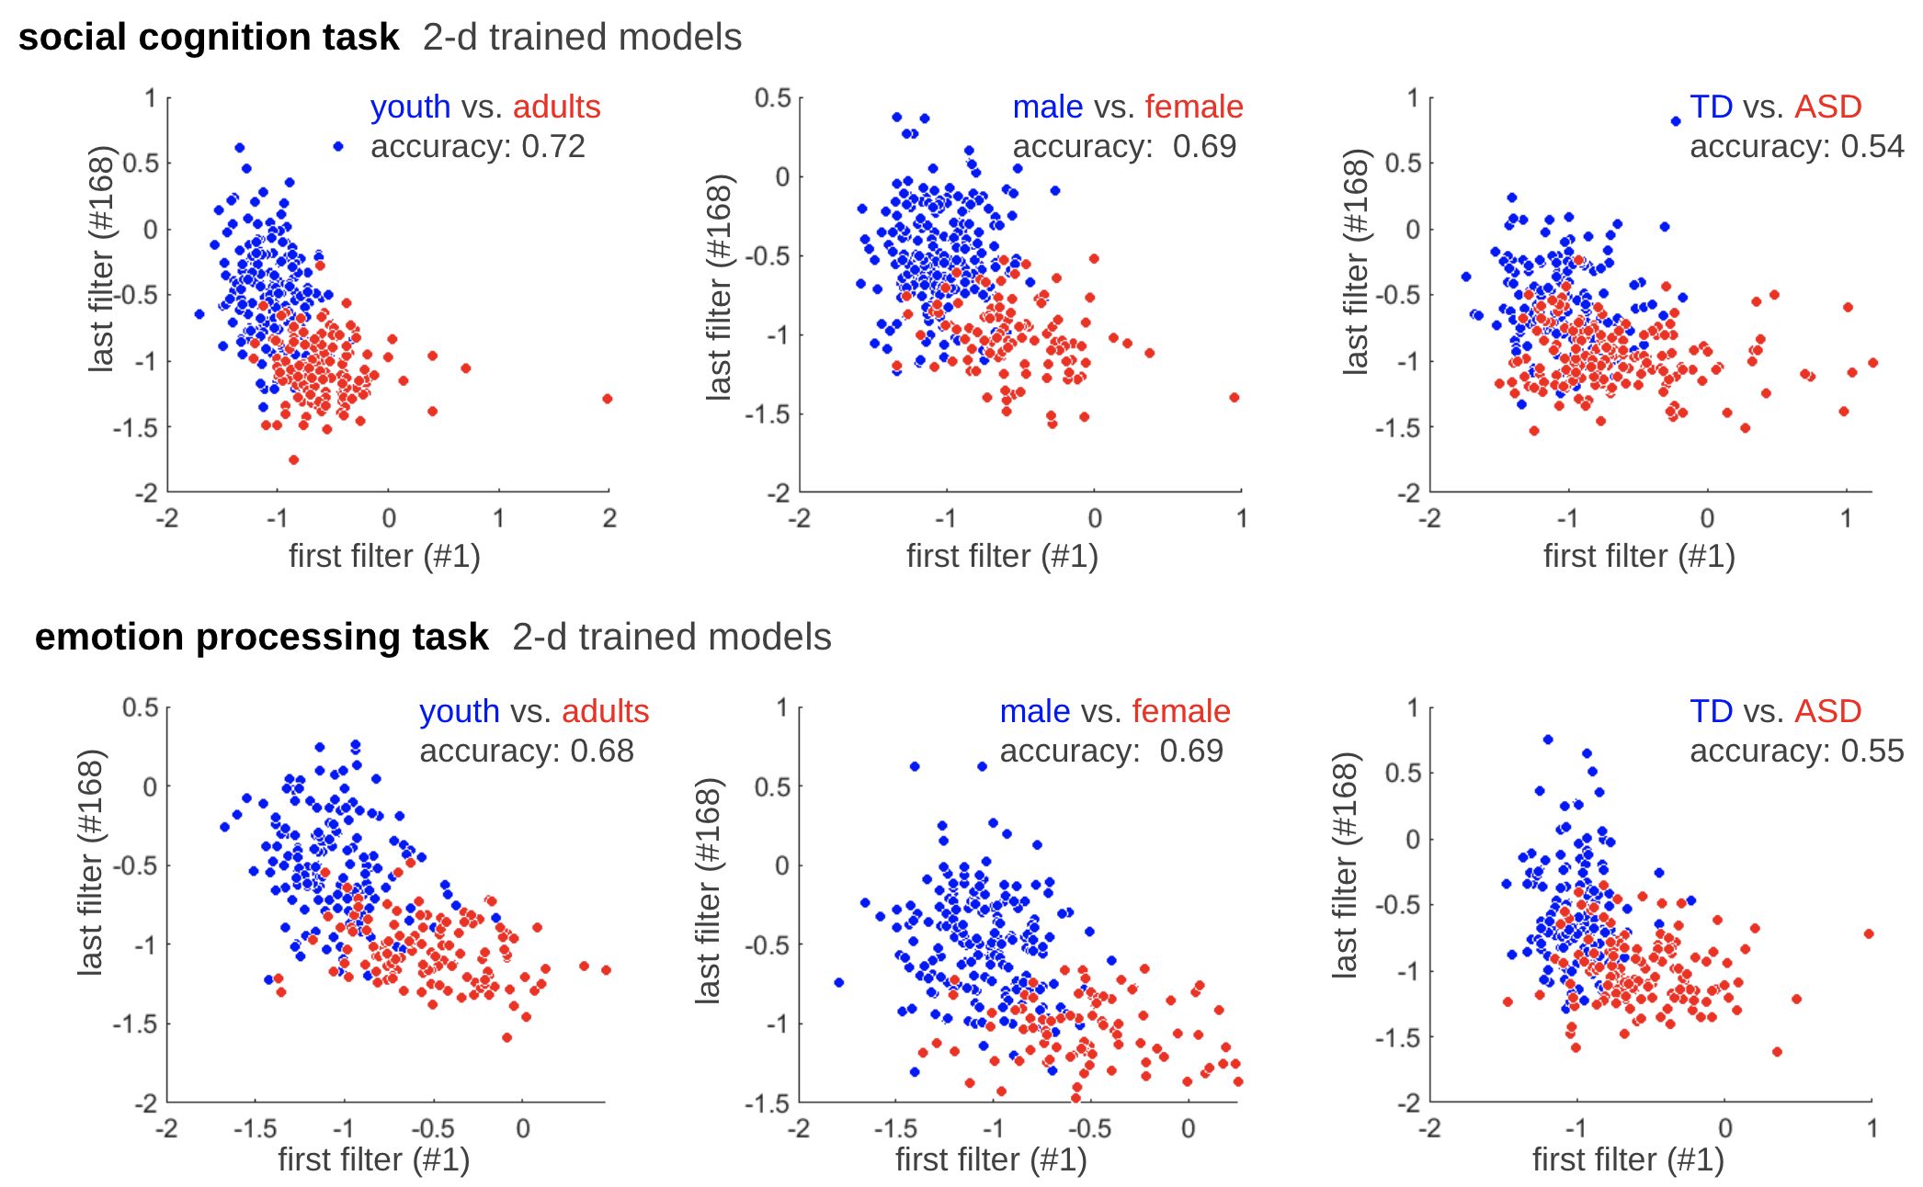
SPADE ♤

Slide 12
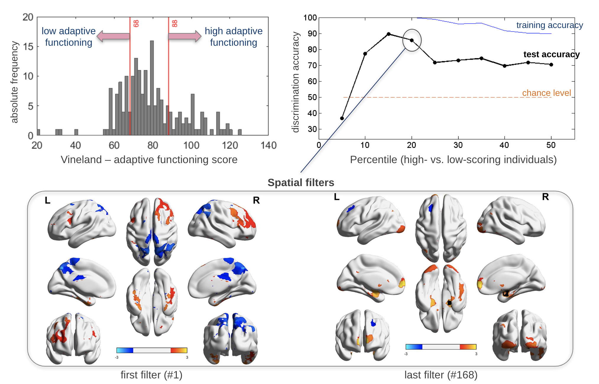
SPADE ♤ adaptive functioning

Slide 13
SPADE 4 STRATIFICATION
Alberto Llera
Statistics in Neuroimage
Donders Centre for Cognitive Neuroimaging
Radboud University Nijmegen
a.llera@donders.ru.nl

Slide 14
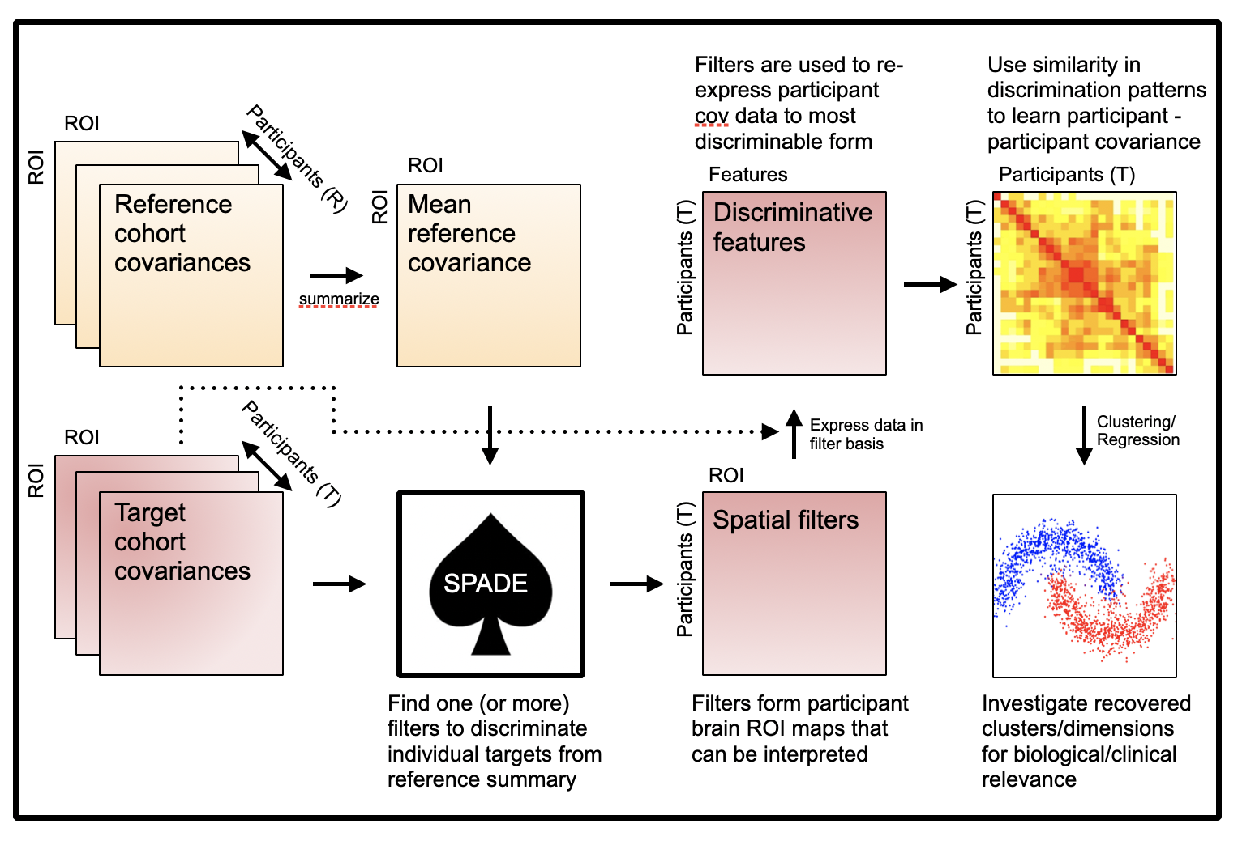
SPADE ♤ Simulated stratification

Slide 15
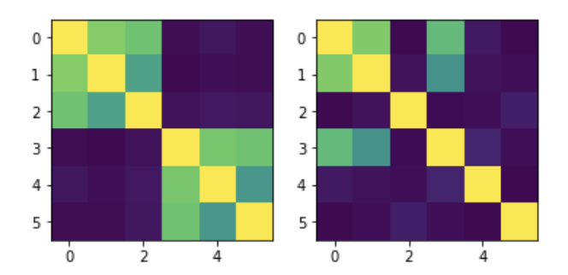
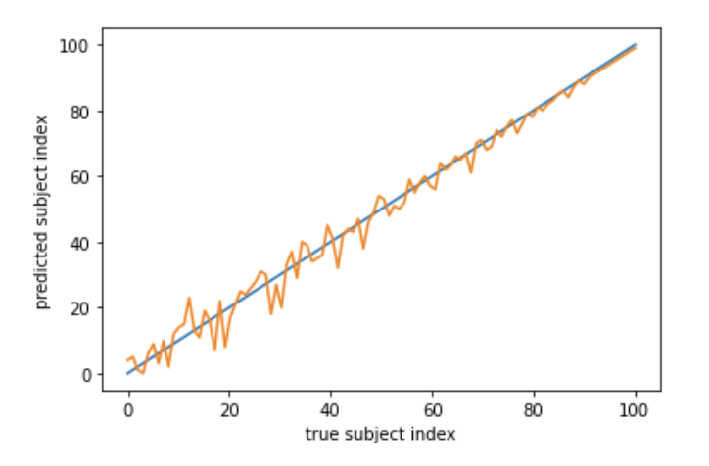
SPADE ♤ Simulated stratification
Assume two covariance structures C1 and C2, e.g. patients and controls
Fix C2 as the covariance of the control group
Define a continuum between C1 and C2
K C1 + (1-K) C2 , for K in [0,1] defined in 100 steps.
This simulates an spectrum of 100 subjects from pure patient to pure control
Can we recover the spectrum using spade?

Slide 16
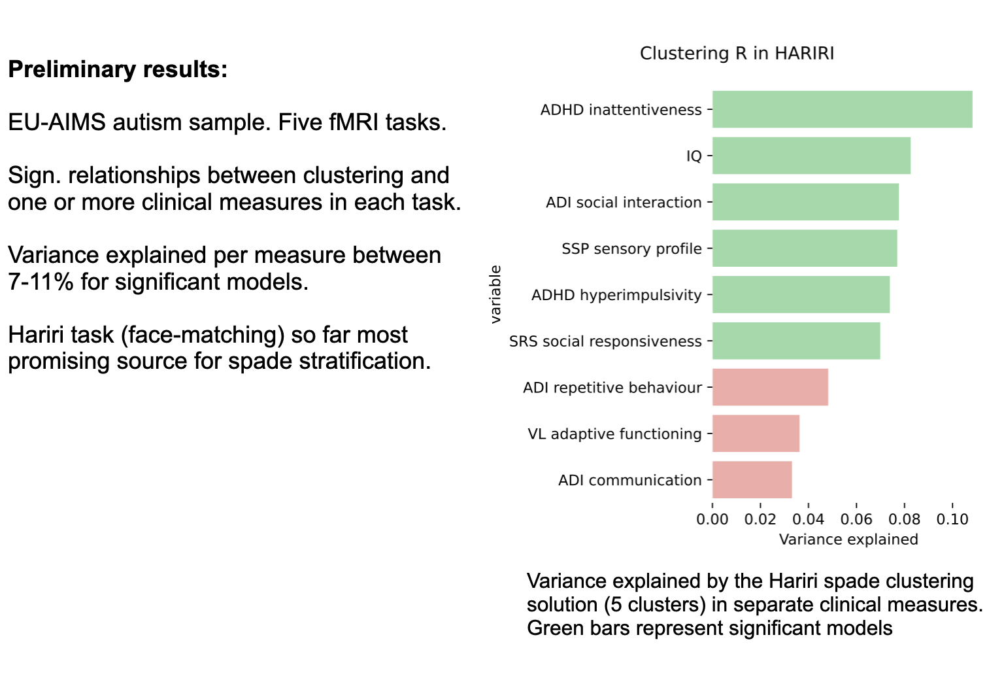
SPADE ♤ ASD stratification

Slide 17


SPADE ♤
I hope you got the idea

